Slide 1
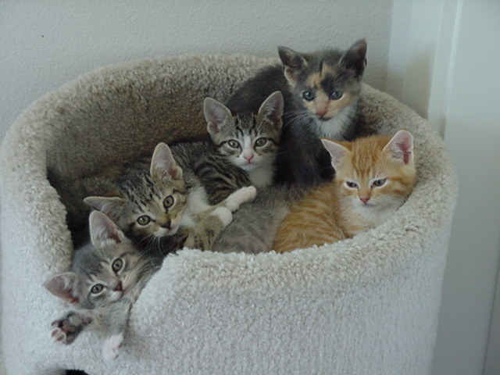


More Than Just Playing with Kittens
Foster Training
Notes:
Remove CAT’s and Maddie’s Fund logo and replace with your own. You’re also welcome to change to your organization’s branding guidelines.

Slide 2
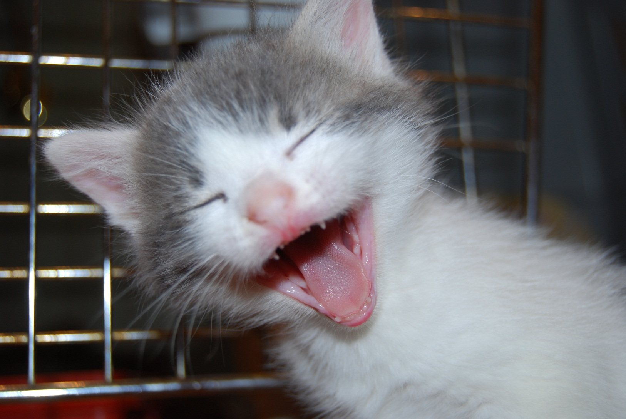
Welcome

Slide 3
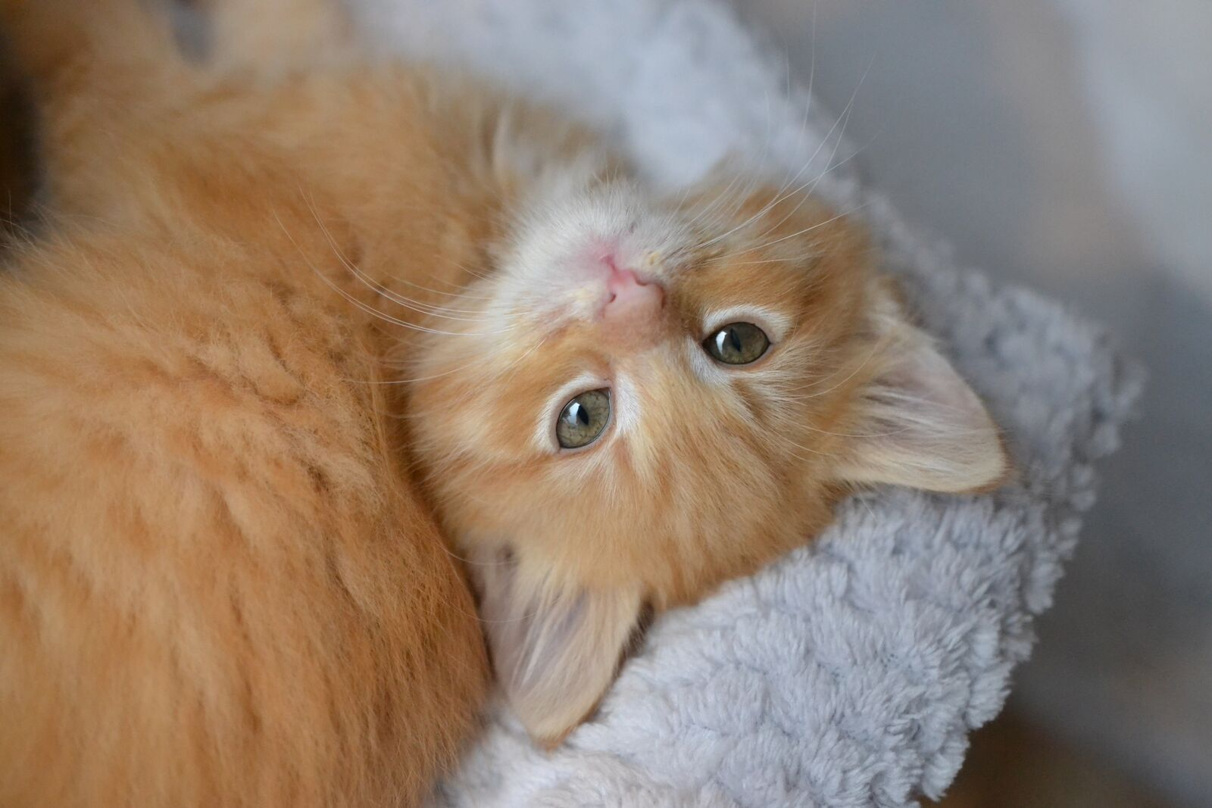
Thank You for Opening Your Heart and Your Home.

Slide 4
Highs and Lows of Fostering
Clean up – possible damage
Separate foster room
Death of an animal
Say goodbye
Socialize them
Use our vets
Not your animals
Financial obligation
Monitor health
Strictly indoors
Adult supervision with children
Own animals current on vaccinations and altering
Saving lives
Making a difference in your community

Slide 5
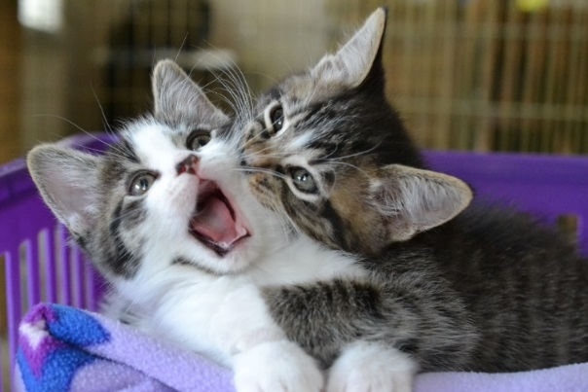
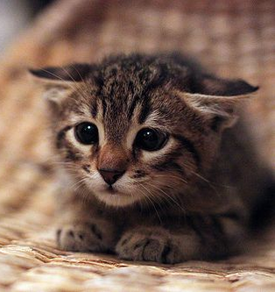
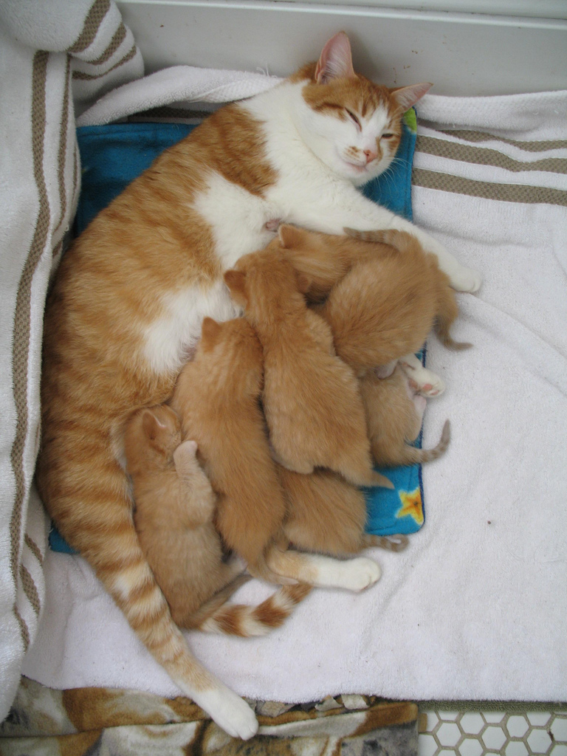
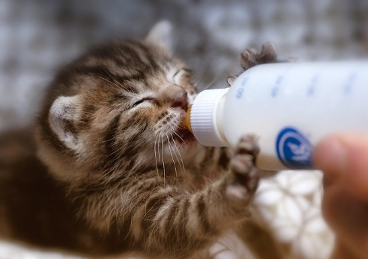
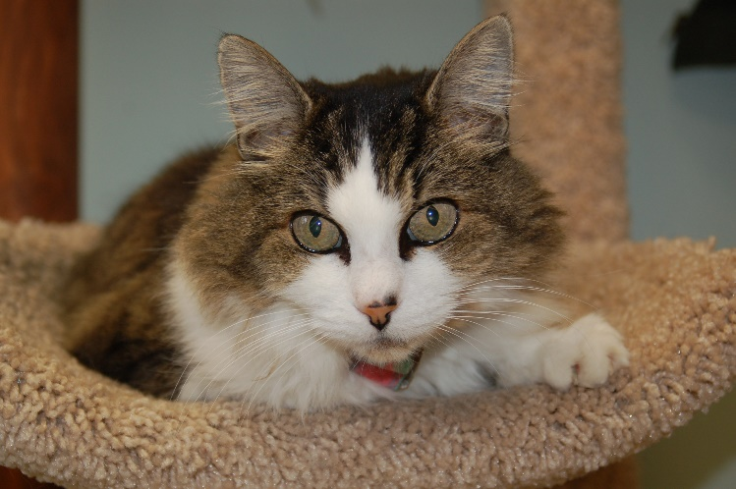
Who Goes to Foster Care?
Orphaned kittens
Socialization
Pregnant moms
Moms + young kittens
Bottle babies
Adults – sick or rehab

Slide 6
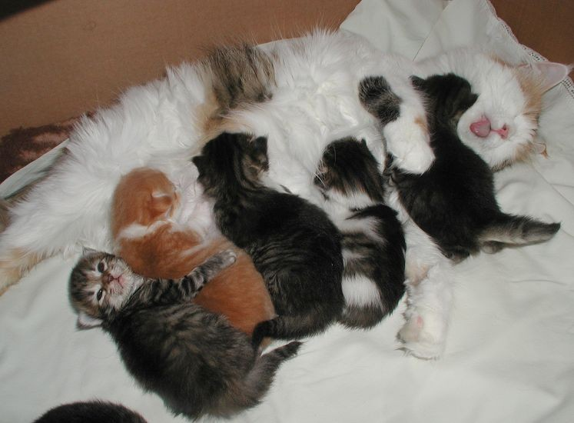
Foster Manual
A wonderful and detailed resource
Reference it often!
Use “Find” function to search the PDF
If you can’t find an answer, ask your mentor or the foster coordinator

Slide 7
Foster Agreement
You will sign this every time you take a litter or a single kitten home with you
It is your responsibility to know what is expected of you
Compliance is a must

Slide 8
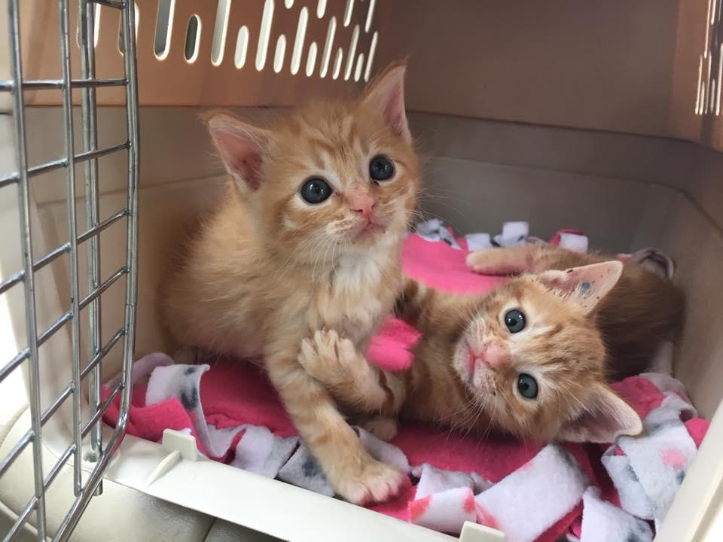
Key Responsibilities
Inside at all times
Carrier when leaving the house
Doors and windows closed
Cat escape
Keep them separate
Mixing with your own pets: are they tested?

Slide 9
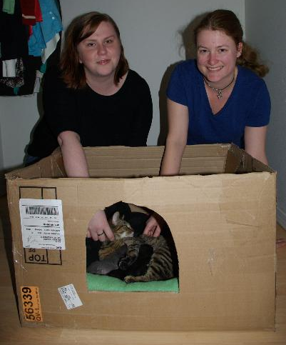
Mentors
Experienced foster parent volunteers
Preventative care
Call with any question
If kitten isn’t doing well
Support system
On-call mentors

Slide 10
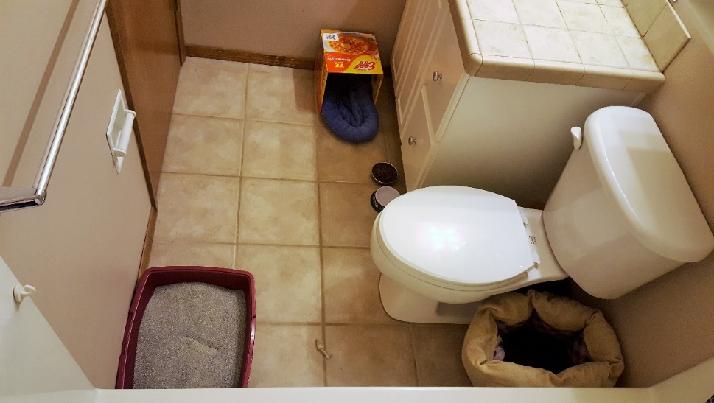
Housing
Places TO use:
Spare bedroom
Bathroom
Den
Places NOT to use:
Garage
Office that is in use
Occupied bedroom
Laundry room

Slide 11
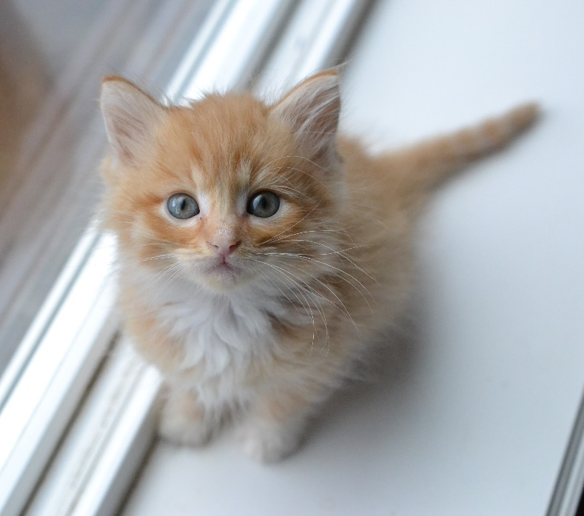
Kitty-Proofing Your Home
Empty room to start
Only items for kittens
Foster baby bag in separate room away from kittens
Cover electrical cords
Don’t use good linens

Slide 12
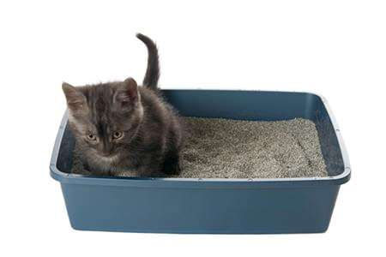
Litter Boxes
The more the merrier
Big one for mom
Little ones/low-sided for kittens
Baking pans/cookie sheets/Dollar Stores
Cardboard boxes from wet food

Slide 13
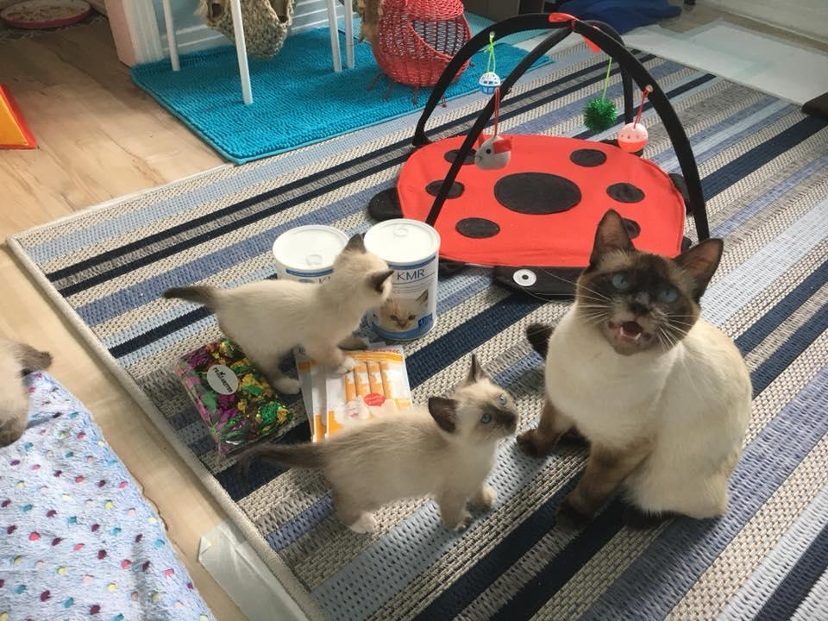
Expenses/Donations
Food
Litter
Litter box
Toys
Scratchers
Mileage to/from shelter and adoption events

Slide 14
Google Group
We have the following groups coming from Washington County on Thursday:
One 12-week old kitten – scared and hissing (socialization class required)
Two 6-week old kittens – happy and healthy
Four 3-week old kittens – needing bottle feeding (bottle baby class required)
Notes:
This is a sample of a foster plea we would send out via the Google group. Please replace with an example from your organization.

Slide 15
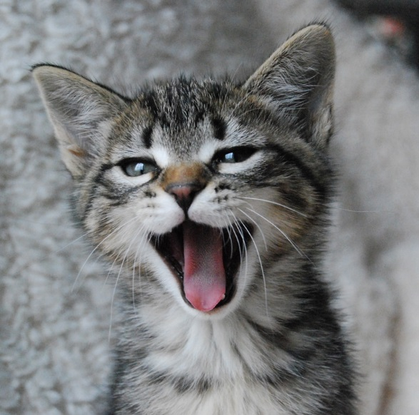
Google Shares
Calendar
Folder “Foster Parents”
Photos
Preventative Care/Medications Form

Slide 16
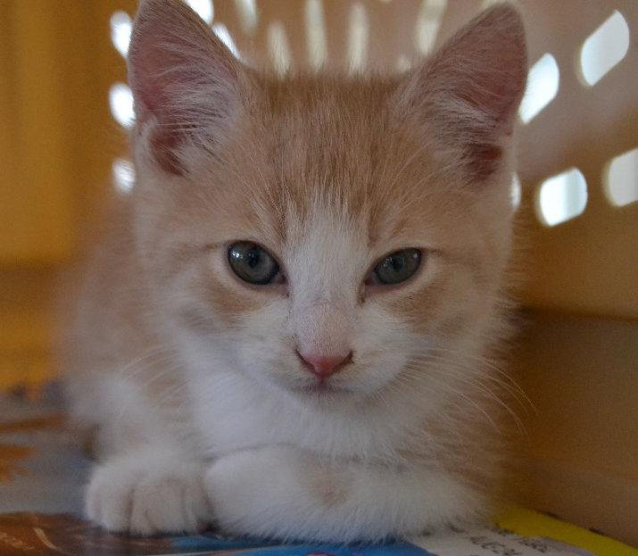
Bringing Them Home
Foster bag full of supplies
Carrier with your kittens
Sign the Foster Agreement
Medical records
Anything else needed
Introductions with kids

Slide 17
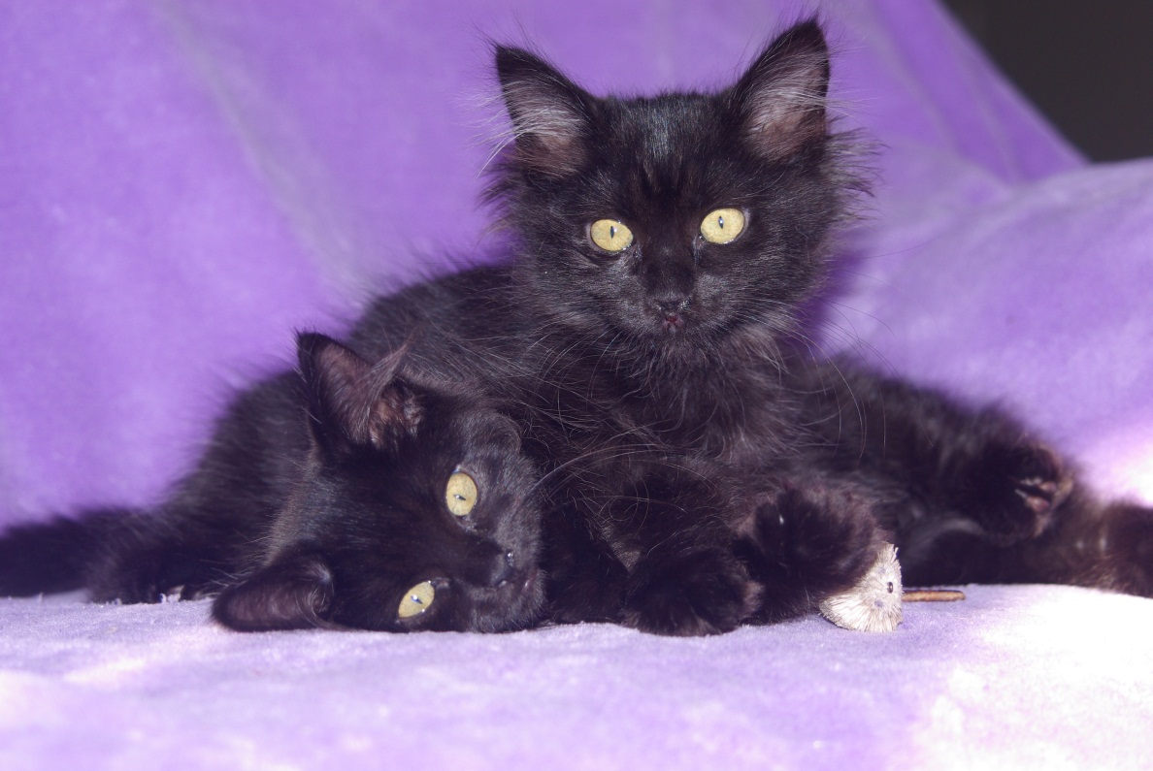
Naming the Kittens
Orphans will already be named
Cannot change orphans’ names
Kittens with a mom cat you will get to name
Cannot change mom cat’s name

Slide 18
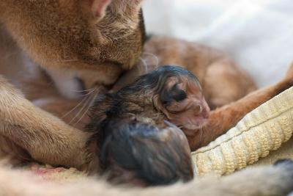
Maternity Guidelines

Slide 19
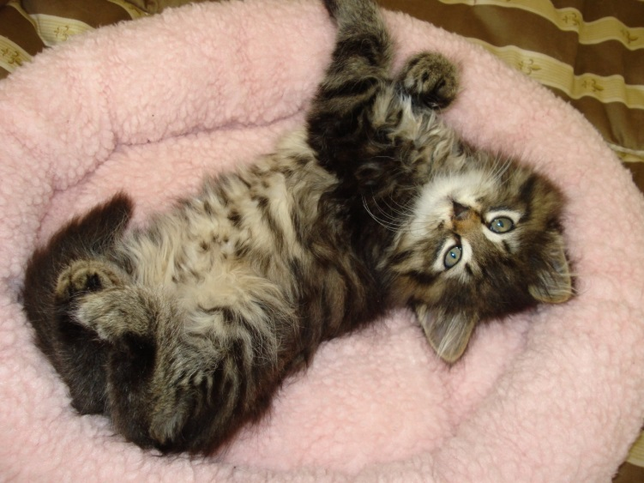
Socializing Kittens
Hands are not toys! Redirect to appropriate toys
Expose to household noises
Meet lots of different people (and children!)
Handle them daily
Our foster program is known for making great cats!

Slide 20
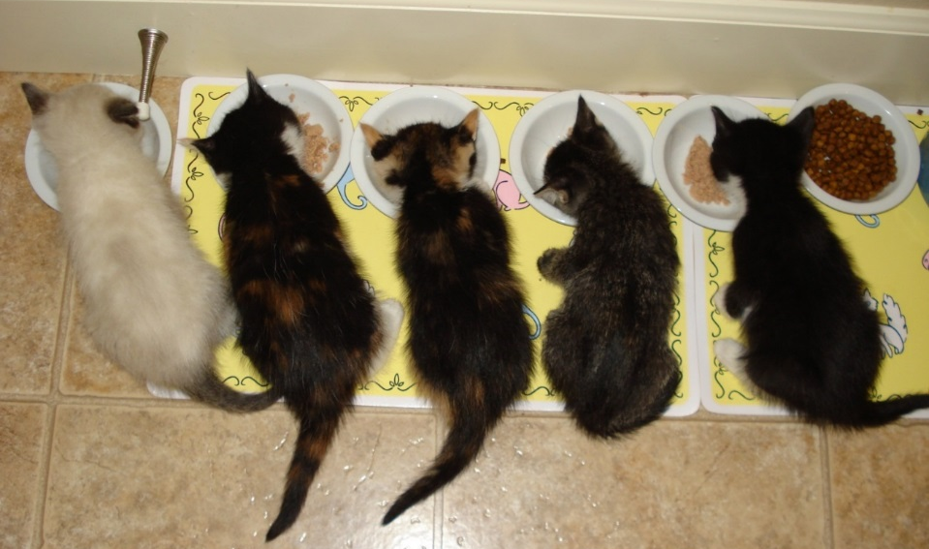
Food
High quality food
Small amount wet 3x per day -> 2x per day
Dry always available
Always lots of fresh water
Watch to make sure everyone is eating!
Supplemental (syringe) feeding if needed

Slide 21
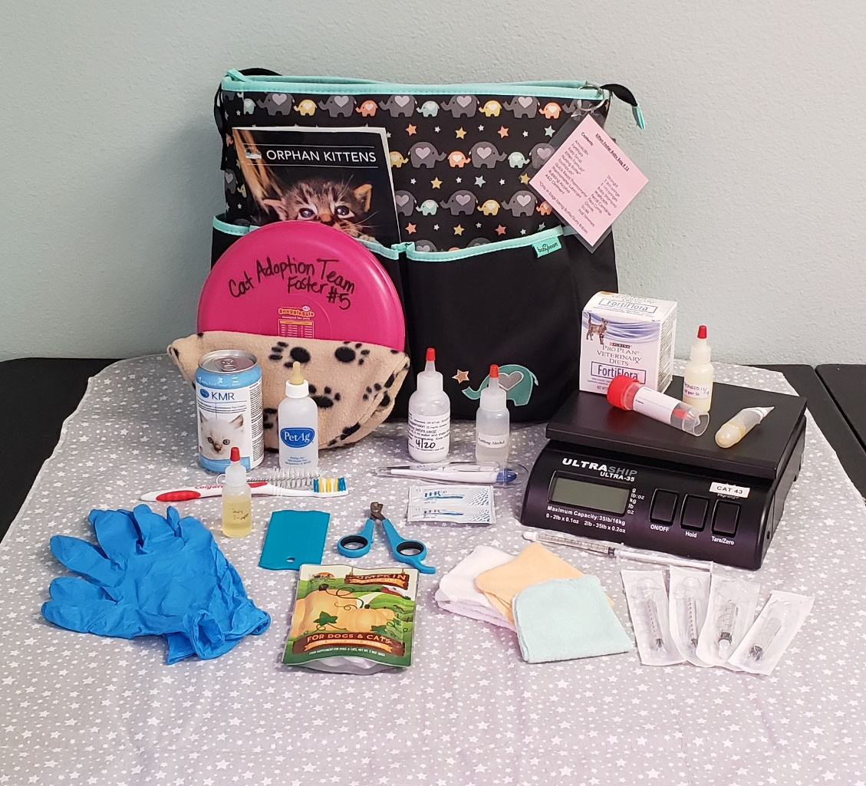
Foster Bag Supplies

Slide 22
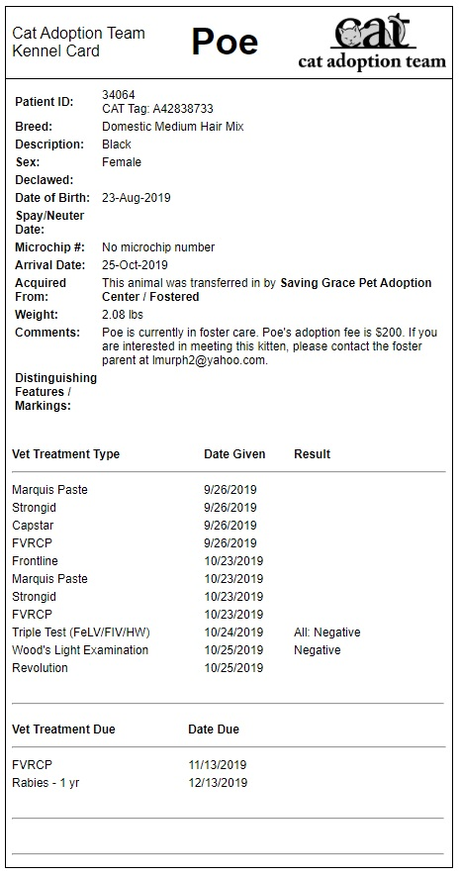
Medical Records
Notes:
Replace with a medical record from your shelter

Slide 23
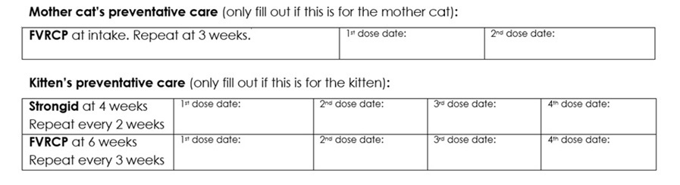
Kitten Development &
Vaccine Schedule
FVRCP – Feline Viral Rhinotracheitis, Calicivirus, and Panleukopenia
Strongid – Roundworm dewormer

Slide 24
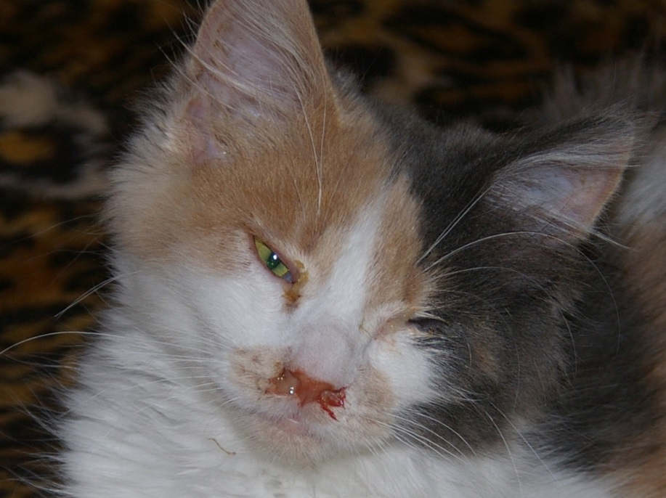
Health Concerns
Discharge from eyes or nose
Coughing
Diarrhea
Vomiting
Straining to urinate or defecate
Bleeding
Lethargy
Fever
Paralysis
Extreme change in attitude
Not eating/drinking
Temperature too low
Temperature too high
Fur loss/scabs
Not gaining weight or reaching milestones

Slide 25
Common Ailments
Expect to see at least one of these while fostering. If you don’t, you are one of the lucky ones!
  Diarrhea
  Upper Respiratory Infection (kitty cold)
  Conjunctivitis
  Vomiting
  Dehydration

Slide 26
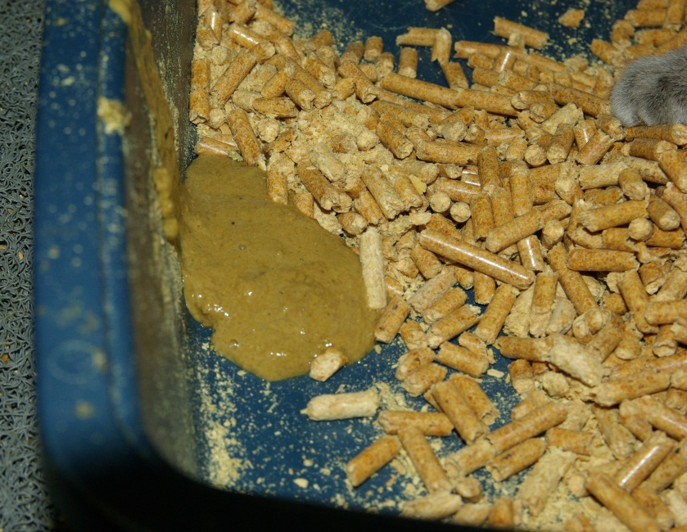
Diarrhea Protocol
Alert your mentor - may need fluids if dehydrated
Fortiflora
Consistent diet
Canned pumpkin
Medication from the shelter
Fecal sample
**Vet appointment if severe**

Slide 27
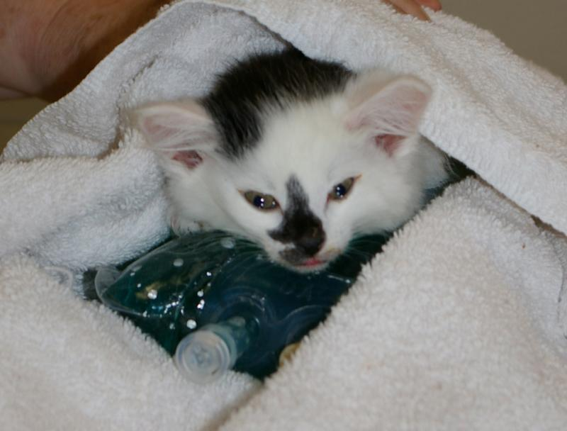
General and
Emergency Care
Your organization will cover all medical expenses done at the shelter
Your organization must approve outside expenses
Foster parents cannot seek medical care on their own without the consent of the shelter
Notes:
Insert your organization’s name.

Slide 28
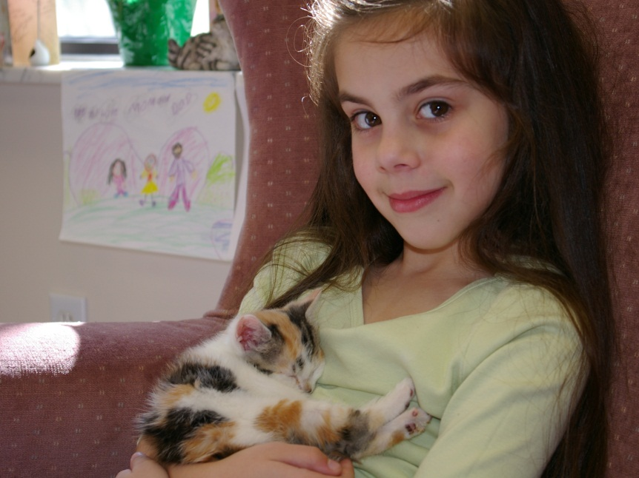
Adoption Process
Pre-Adoption vs. adoption
Foster parents can adopt
No holds in foster care
Kittens do not go home until they are altered – no exceptions!

Slide 29
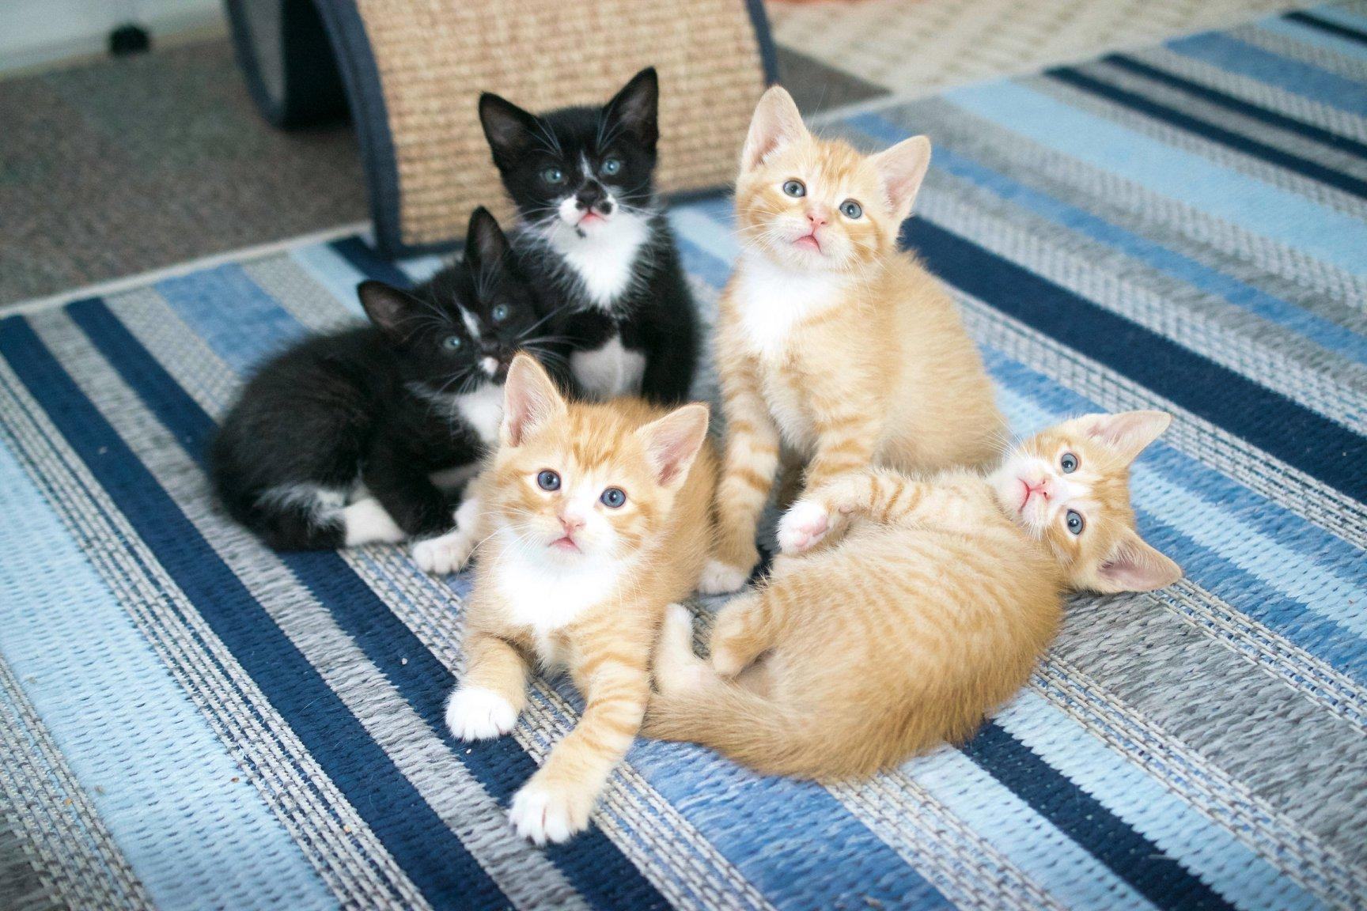
A Free Kitty is NEVER Free!

Slide 30
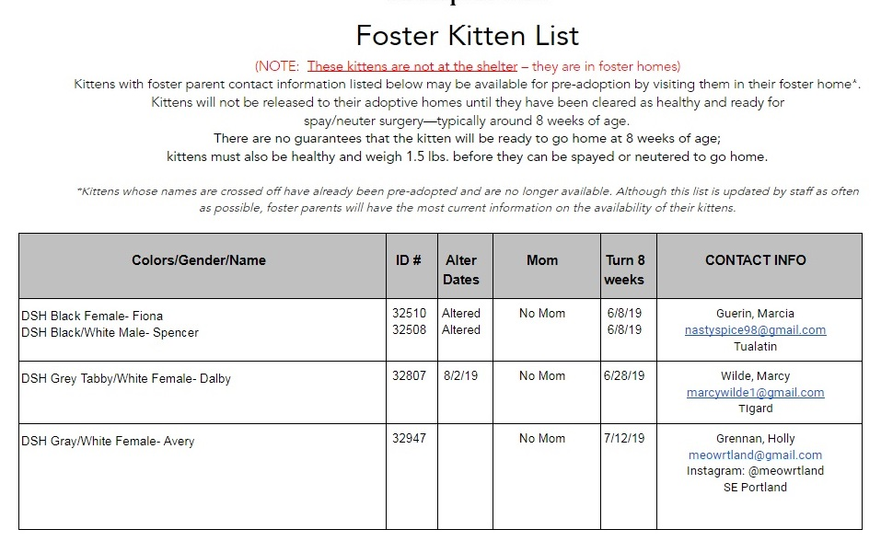
Kitten List

Slide 31
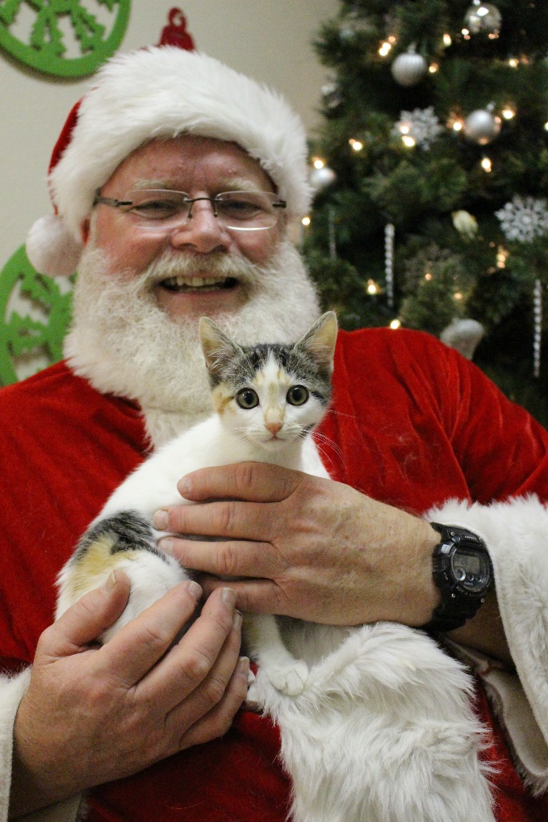
Get Your Kittens Seen
Petco, Petsmart
Opportunities are limited
Look for announcements in your email
Kitten Palooza in June!
Notes:
Replace with relevant information regarding your organization’s offsite opportunities

Slide 32
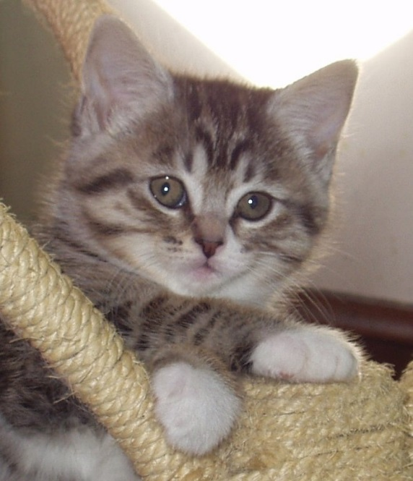
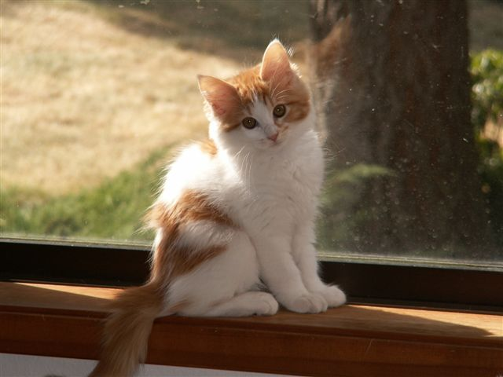
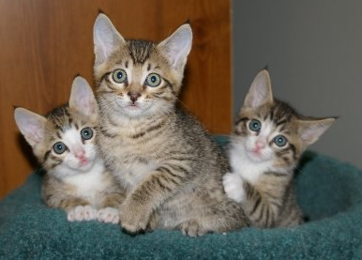
Petfinder – 6 weeks and older

Slide 33
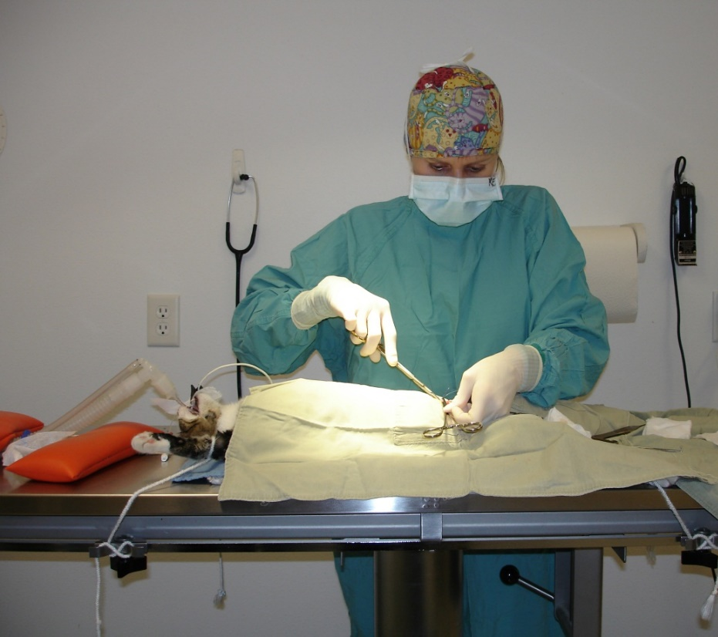
Returning Kittens for
Surgery or Adoption
Surgery
Email when kittens are 1.5 lbs
If pre-adopted, let adoptive family know the surgery date
Fill out Personality Profile
Fill out Foster Return Form
Collar kittens
Hand in foster bag and all supplies

Slide 34
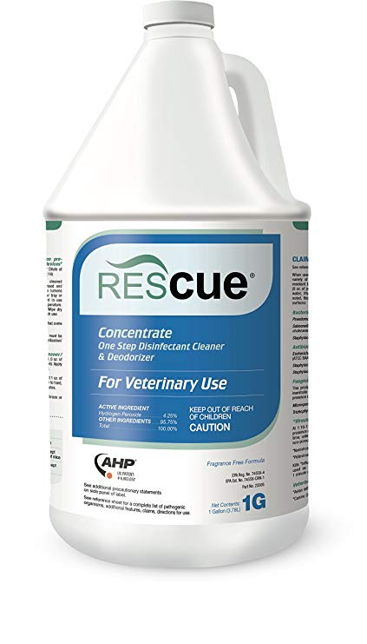

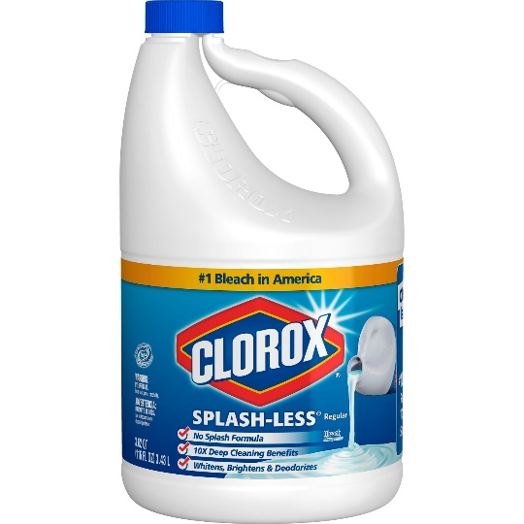
Cleaning for Your Next Group
Throw away disposables
Bowls/toys – dishwasher
Bedding/toys – washer on hot cycle w/ bleach
Litterbox/floors/walls – wash with hot, soapy water, then 1:32 bleach for 10 min
Can also use Rescue

Slide 35
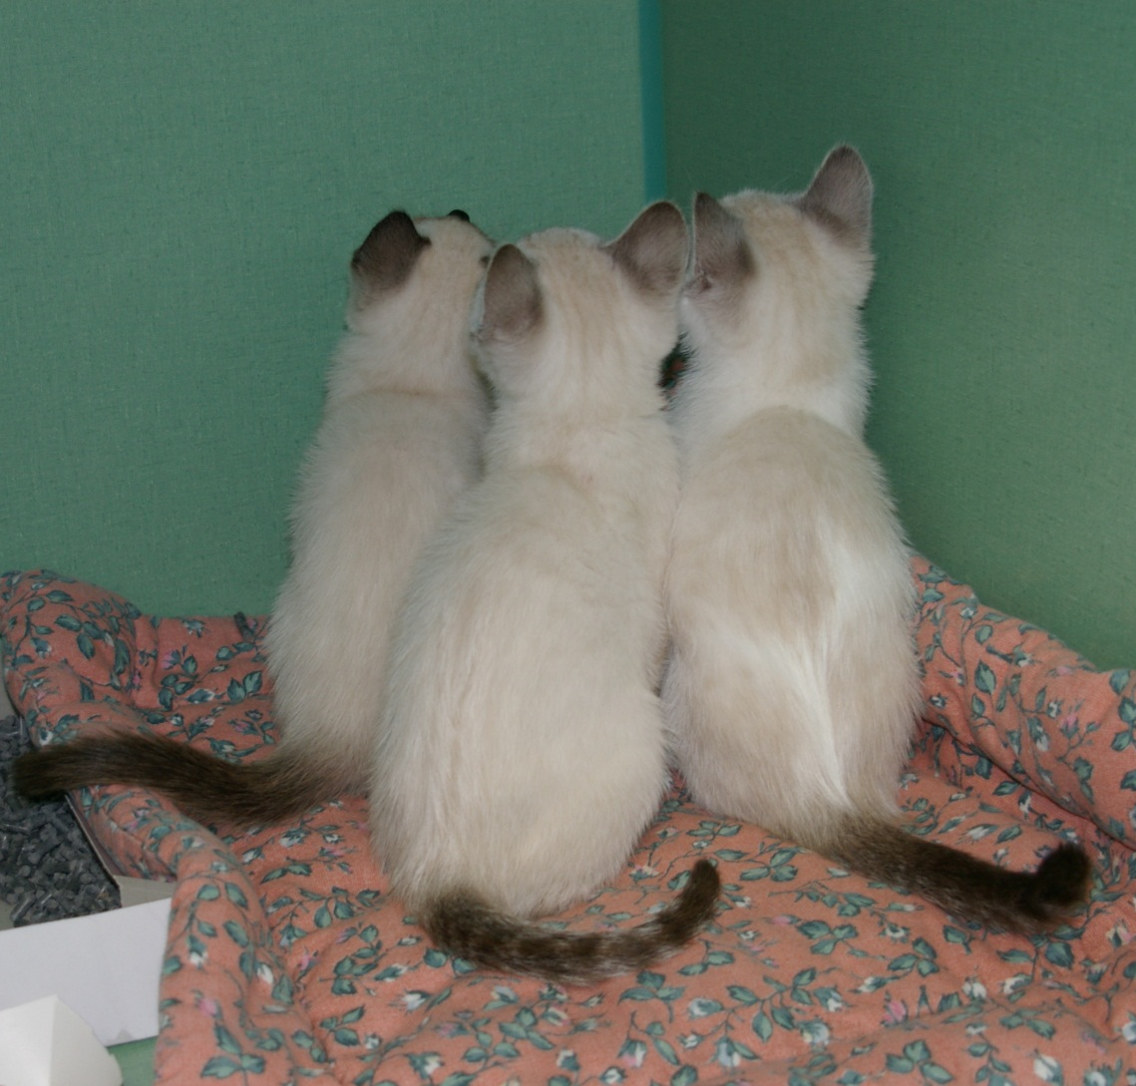
FAQ’s

Slide 36
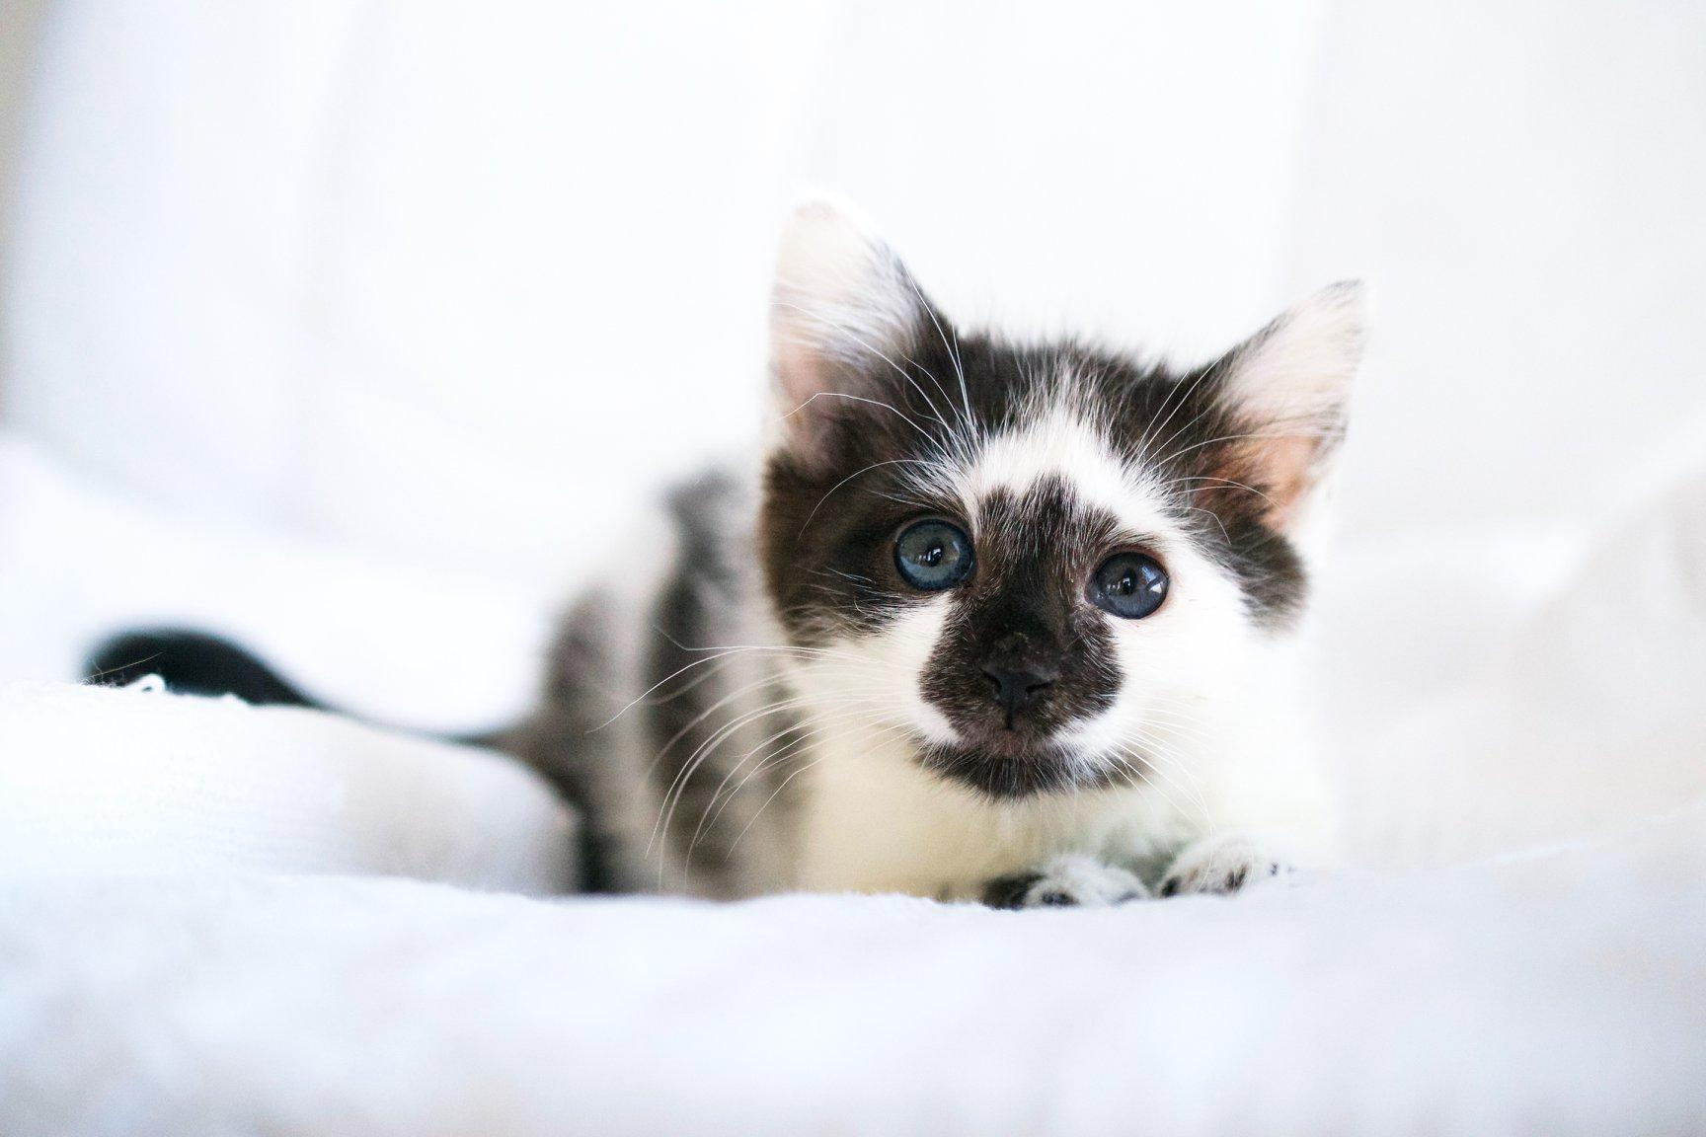
Questions?

