Slide 1
Mentoring Is All About
Helping People Be Successful
Notes:
This PPT is on CAT’s Fostering 4 Rock Stars template. To customize it for your organization, you will need to change the template on the design tab.

Slide 2
Welcome & Introductions

Slide 3
What It Takes To Be A Mentor
Experience
Emotional intelligence
Respect for CAT’s protocols
Empathy
Composure
Problem solving
Notes:
Fostered for at least one year
Fostered various groups
Calm under pressure
Good with people and pets
Coach, problem solve
Understand chain of command
Supplies are only for foster kittens
Know your own limits
Be an active learner
Above and beyond regular fostering
Reliable transportation
Good communicator
Has extra hours each week to help foster homes
Your Vet likes to work with them
Supports Foster Coordinator
Trusted and reliable
Great shelter representative
Knows what questions to ask

Slide 4
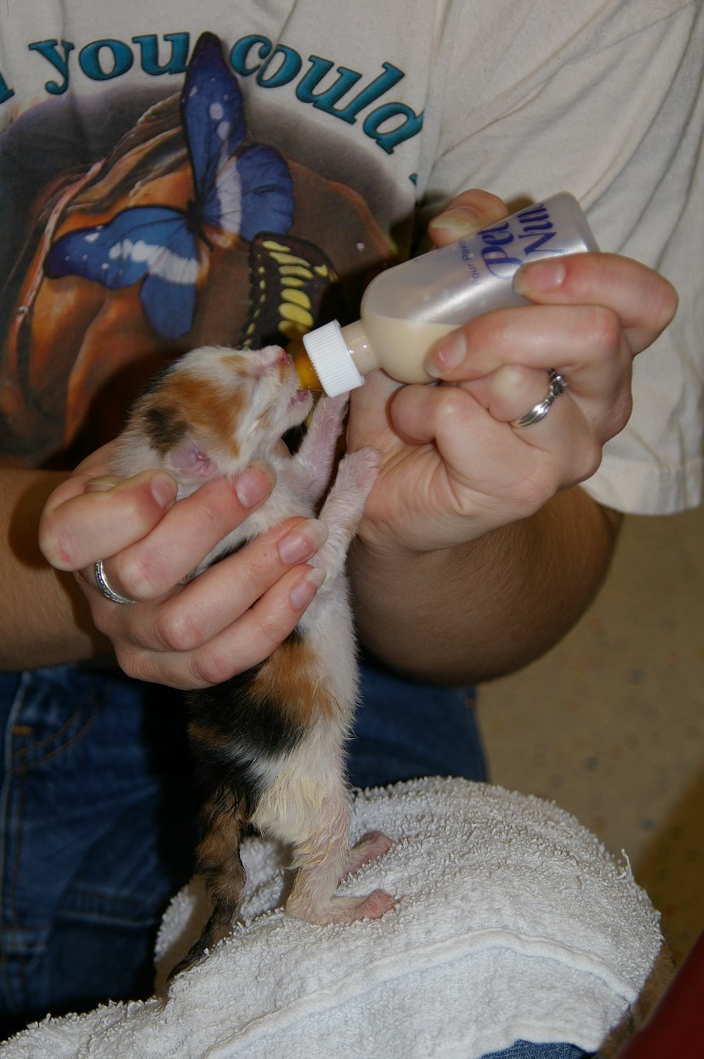
Key Responsibilities
Phone calls, texts, and emails
Recognize illness
Treat illness per policy
Mentor bag stocked
Get kittens to eat
Know foster rules and policies
Elevate concerns

Slide 5
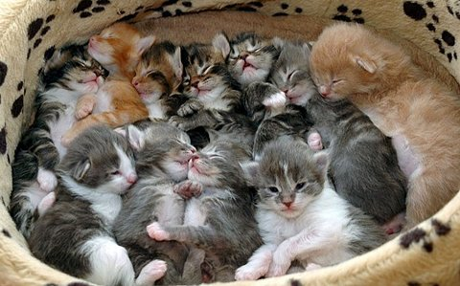
How Many Is Too Many?
Know your limits
Only take on foster parents if you have time
Each litter of kittens takes time away from family and friends

Slide 6
Know Your Foster Parents’ Limits
Family support – who is involved
Young children when kittens get sick
Possible death – pull kittens or leave?
How far away are they from you?
What skills do they have?

Slide 7
Foster Mentees
You take on a new foster family:
Contact them within 48 hours of taking kittens home each time they pick up
Visit their home
Check out foster room
Offer suggestions if needed
Check out kittens

Slide 8
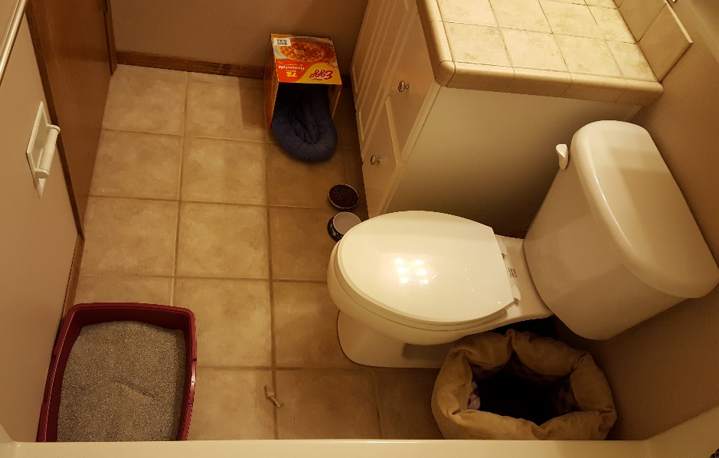
Foster Room
Good Places:
Bathrooms
Empty Bedrooms
Dens
Offices not in use

Slide 9
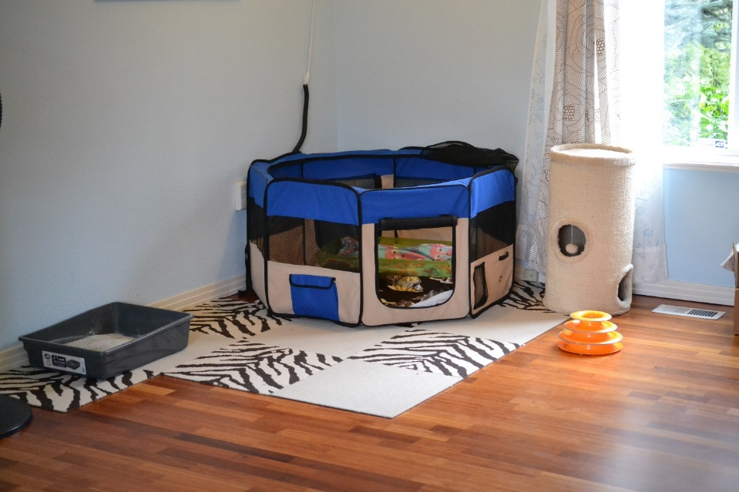
Foster Room
Things to watch out for:
Cords
Small items like paperclips
Razors
Soap
Cleaning supplies
Knickknacks

Slide 10
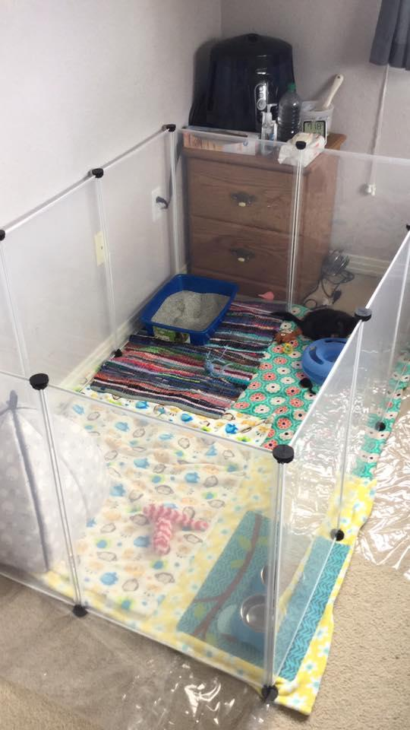
Foster Room

Slide 11
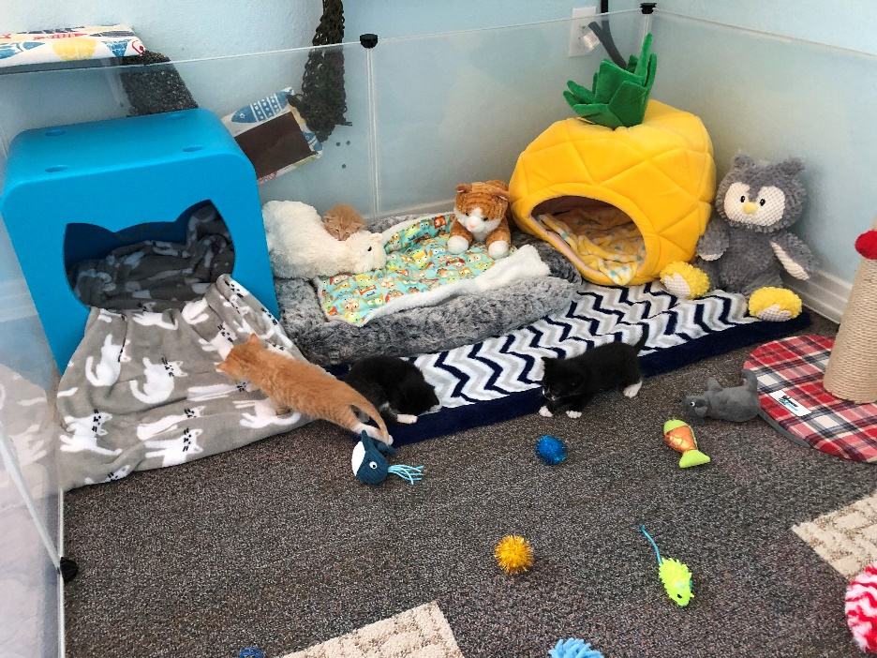
Nesting Boxes
OPTIONS
Notes:
Cardboard boxes – new each time
Large carriers

Slide 12
Keep It Organized
Wall calendar
Organizer/planner
Outlook calendar
Google calendar
Smart phone calendar
Wall calendar in a binder

Slide 13
Routine Care
Vaccines
Worming treatment
Ear mite treatment
Flea treatment

Slide 14
Mentor Assistants
Support mentors and foster families
Administer vaccines, fluids, topical medications
Assist with identifying and treating illness according to protocol

Slide 15
Litter boxes
The more the merrier
Clean at least twice a day
Don’t use clumping until 8 weeks of age
Kitten Attract when they won’t use the litter box

Slide 16
Ailments
What is their temperature?
Are they eating?
Are they going potty?
Are they playing?
Diarrhea?
Vomiting?
Anything else?

Slide 17
Getting Them to Eat
Smelly wet food
Human baby food– no onion or garlic
Boiled chicken– no seasoning and skinless
Save the broth– ice cube trays
Prescription AD
Slurry aka “Kitten Crack”– AD, baby food, KMR

Slide 18
Calicivirus
Yellow or green discharge from the nose and/or eyes
Fever 102.7 or higher (typically high spiking fever)
Drooling
Mouth and/or nose ulcers
Lethargic
Not eating

Slide 19
Upper Respiratory Infection
Yellow or green discharge from the nose; fever of 102.7 or higher; drooling; watery eyes or discharge from eyes; 3rd eyelids are up; lethargic; not eating.

Slide 20
Conjunctivitis

Slide 21
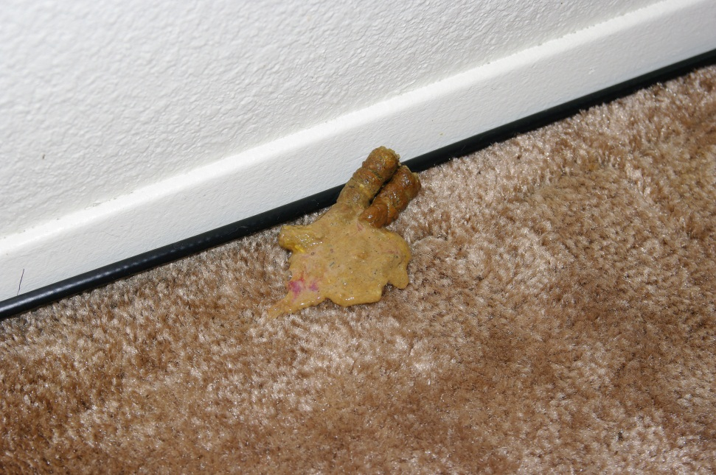
Diarrhea

Slide 22
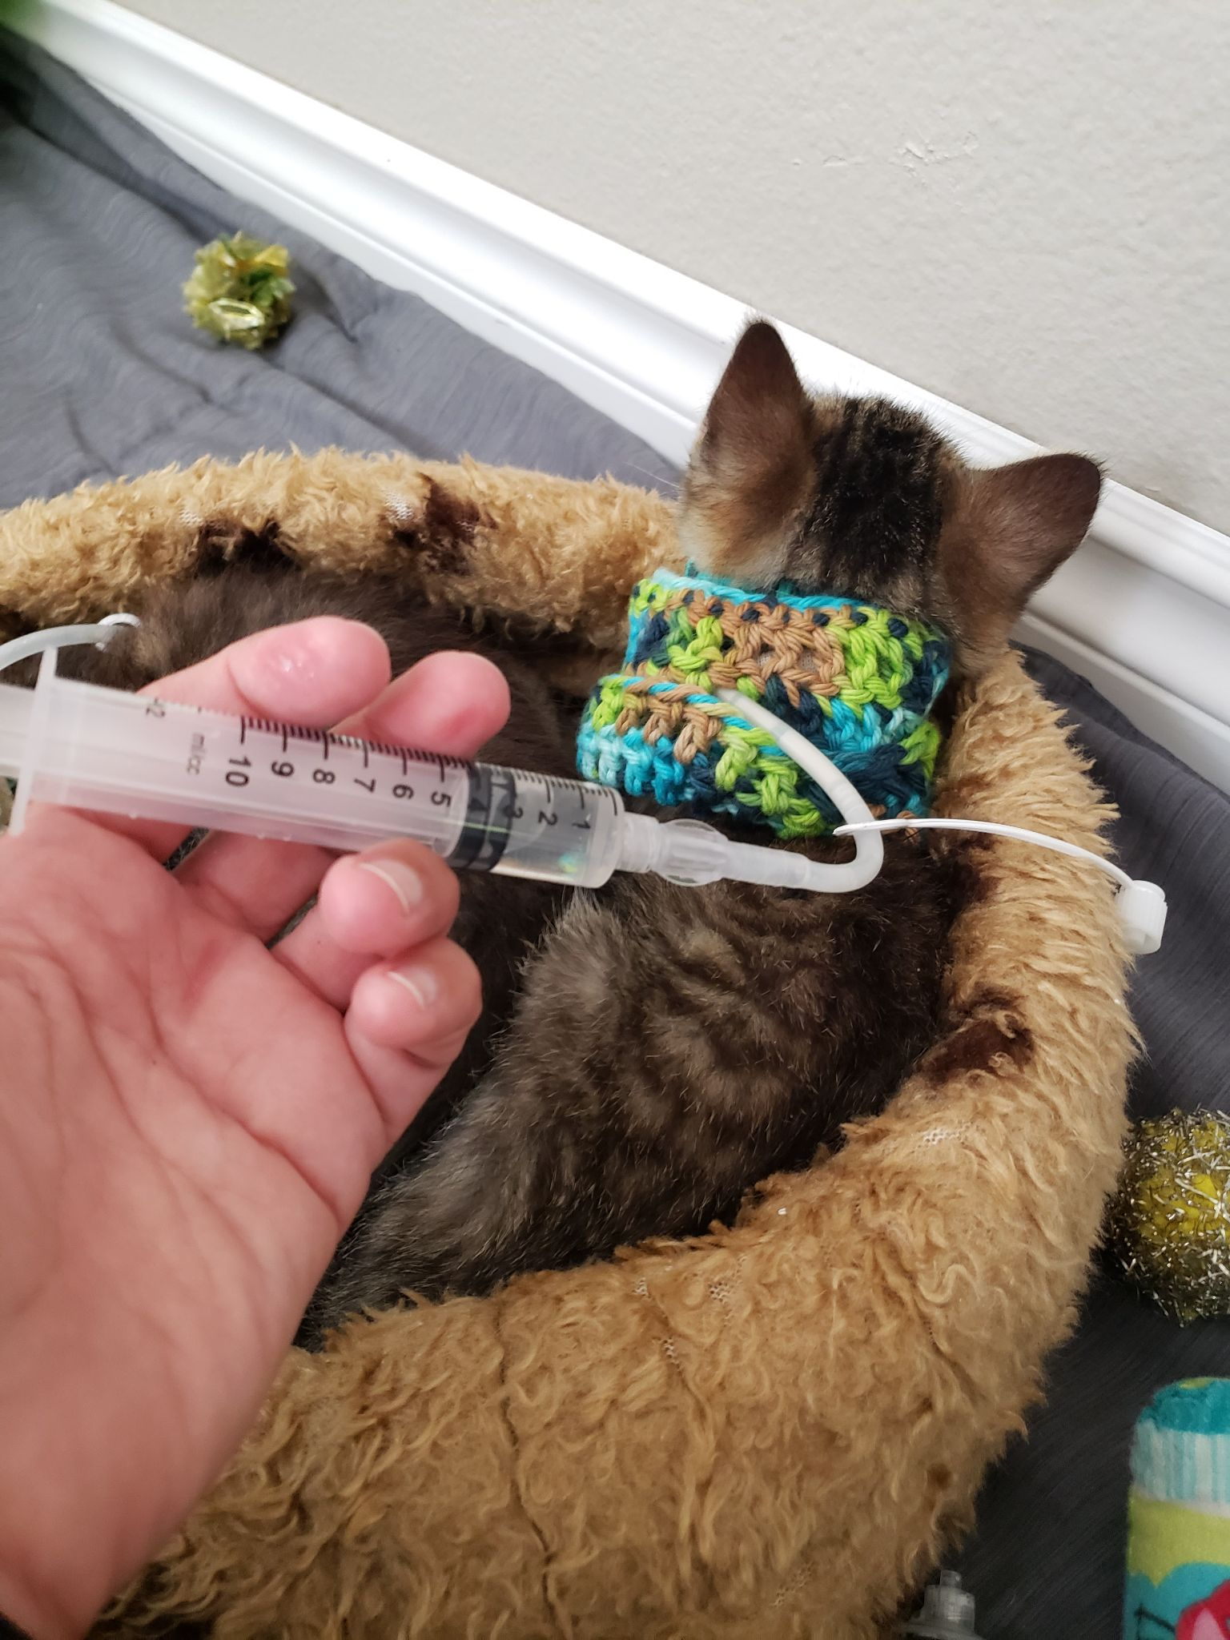
Rehoming Kittens
Know when it is time
Be a back up if needed
Planning for vacations
Kittens get sick – now what
Know who approves rehoming and how that works

Slide 23
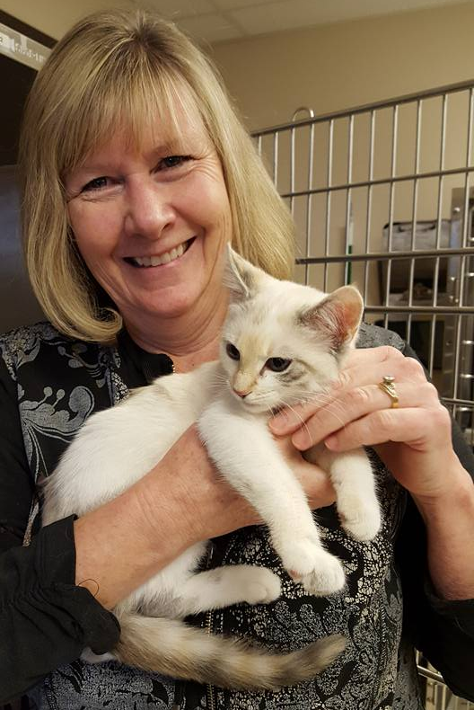
Socializing Kittens
Hidey box
Mama mews
Slow blinks
Paintbrush/hand
High value food
Play therapy
Picking up/time in lap
Monitor progress
Tough love
12 days later
Pooh Bear- Before
Notes:
Give out socialization handout

Slide 24
Mentor Bag

Slide 25
Mentor Bag Supplies
A+D ointment
.5 oz. of KY
Yorker of rubbing alcohol
Yorker of water
Sharpie to mark the sub-q bag
4 oz. of hand sanitizer
Gloves
Different foods/can foods
Evo chicken (purple label)
Avoderm chicken (red label or pink label)
Bag of ground up dry kitten food
Small vaccine cooler bag
Scale
Flea comb
Long cotton swabs
Note pad and paper to write notes down or instructions to hand to foster parent
1 bag of lactated ringers solution
5 ea. scalp vein set 23G/19G
1 ea. 50 ml syringe
3 ea. 3ml syringe
2 ea. 1ml syringe
5 ea. 18G needles
2 bottles of Amoxi
Bottle of Panacur
Bottle of Marquis Paste
Karo in syringe
Strongid
Kaolin
Gauze pads
Little Noses saline & decongestant
Old plastic peanut butter jars for sharps
Fast reading (flex tip) thermometers

Slide 26
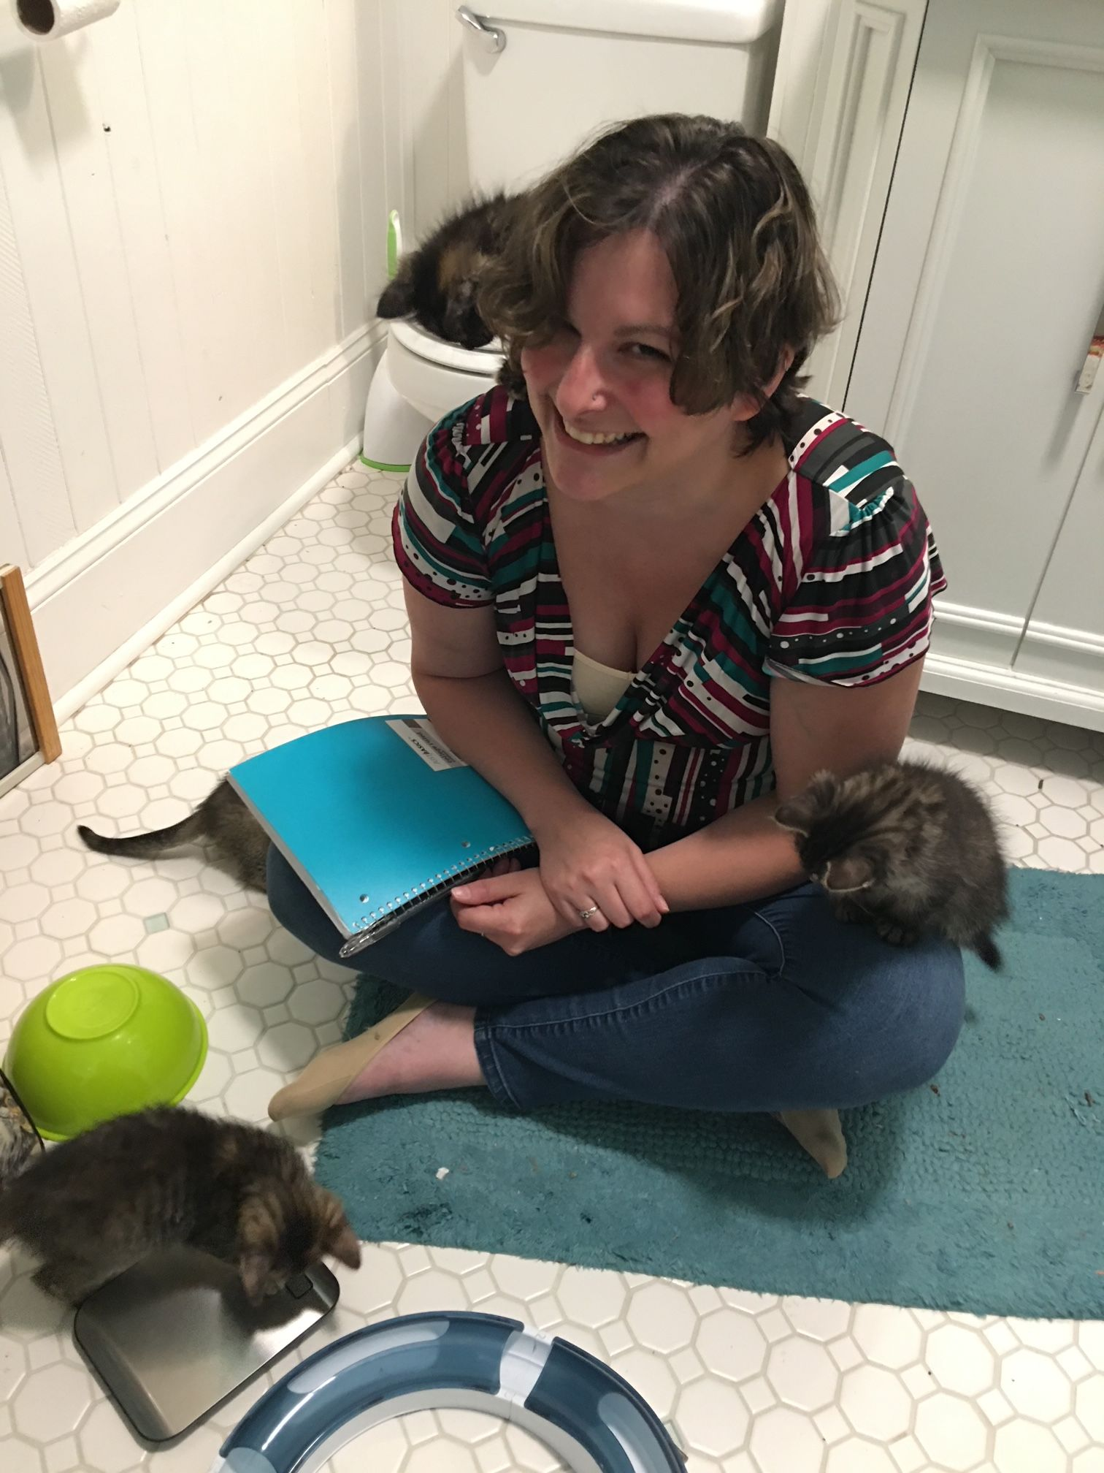
On-Call Mentors
Each week a new On-Call Mentor takes calls from Mentors who need additional help.
They can be staff or volunteers.
If staff, pay them a stipend or the time they are on the phone.

Slide 27
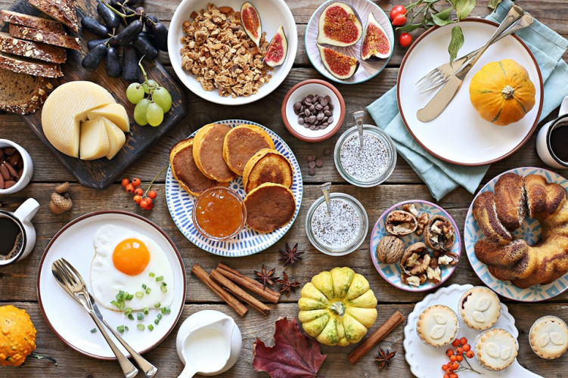
Mentor brunches
Quarterly meetings
CE opportunity
Discuss new foster protocols
Receive feedback from mentors
New ideas for program
Photo credit: events.time.ly

Slide 28
Grief Counseling
When to talk
When to listen
What to say
Remind them of the good
Let them cry

Slide 29
Aging Kittens
Take in account everything you know
Teeth
Weight
Eyes
Mobility/Agility
Number in litter
Average weight of litter
Length of legs
Fluffy coat vs. slicker coat
Round belly vs. sleek body

Slide 30
Sexing Kittens

Slide 31
Boys or Girls?

Slide 32
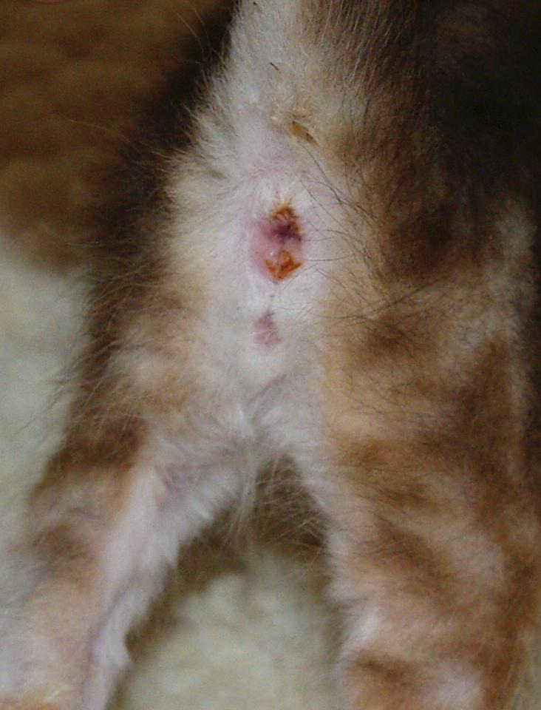
Boys or Girls?

Slide 33
Questions?

